Slide 1
Applying Object Detection to watch in-game ads
BY
Awwal Alagbe and Temidire Dimowo

Slide 2
Introduction (and Motivation)
Problem of Study
Related work
Methodology
Experiments and Results
Discussion/Limitations
Conclusion/Future Work
Contribution of each of the team members
Outline

Slide 3

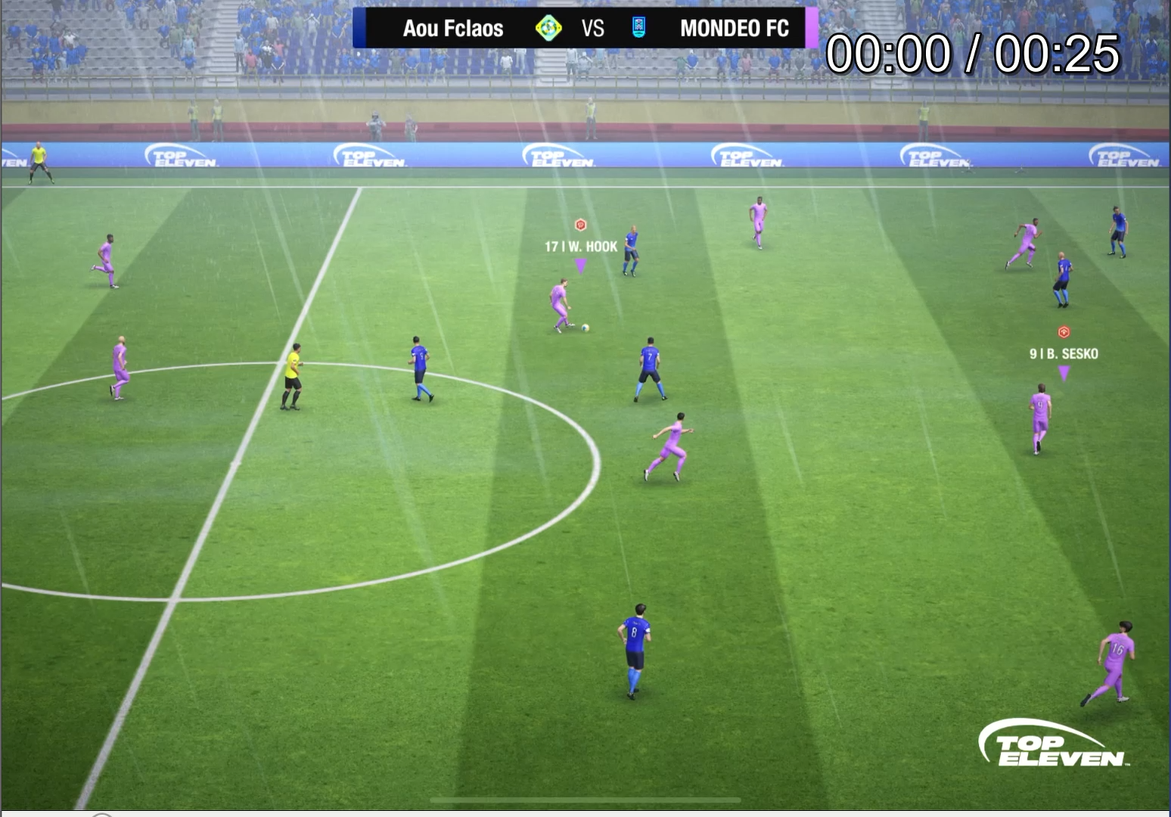

Introduction (and Motivation)
Notes:
Motivation is to reduce the time spent playing games while maintaining the same results

Slide 4
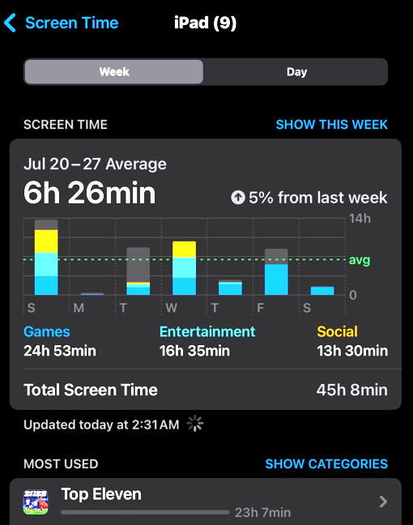
Introduction (and Motivation)
3 hours 30 minutes per day
Watching Ads
to
earn resources
Playing matches
Training Players
Notes:
Motivation is to reduce the time spent playing games while maintaining the same results

Slide 5
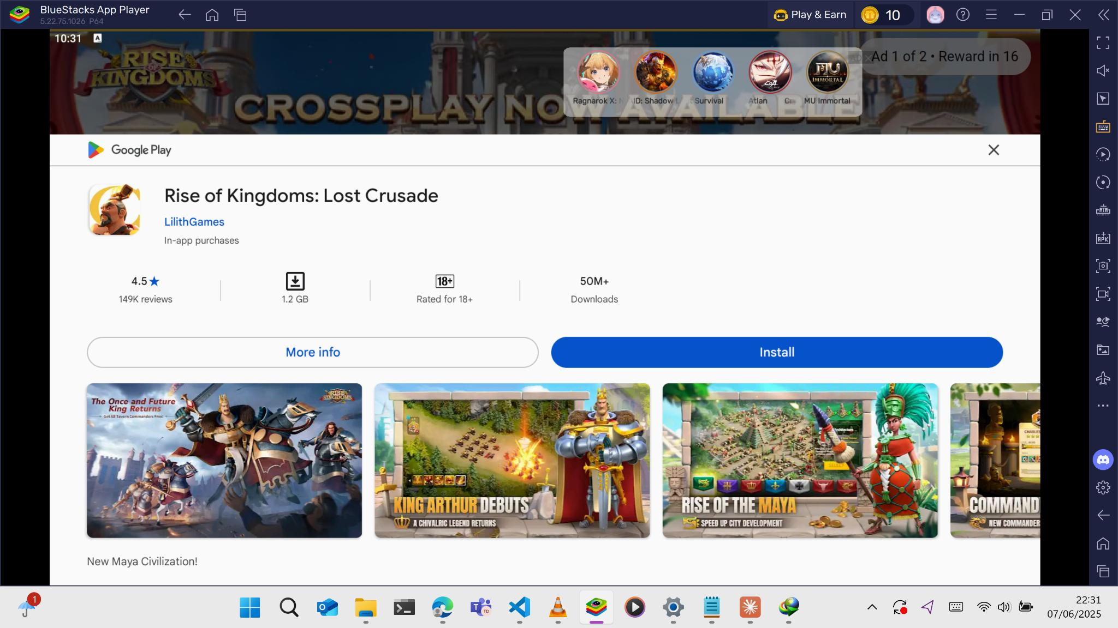









Problem of the study
Identifying and interacting with in-game elements
Close and Skip buttons
Notes:
Motivation is to reduce the time spent playing games while maintaining the same results

Slide 6
Existing Screen-Based Automation
Primarily uses template matching or hard-coded coordinates
Lacks Flexibility
YOLO-based GUI automation
Some attempts at YOLO-based GUI automation exist but are limited in scope and emulator integration
Pure rule-based systems fail with UI changes
Full UI-testing frameworks are heavy and not optimized for real-time use
Related Works

Slide 7
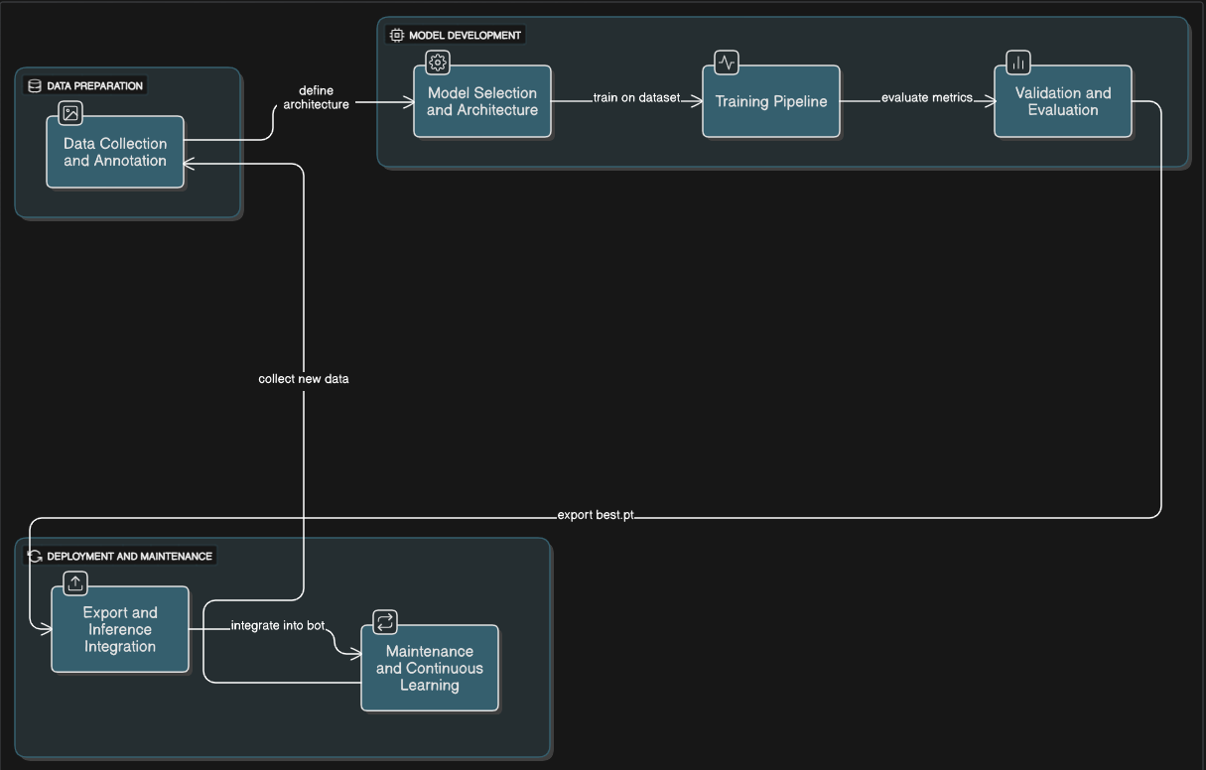
Methodology
Notes:
Motivation is to reduce the time spent playing games while maintaining the same results

Slide 8
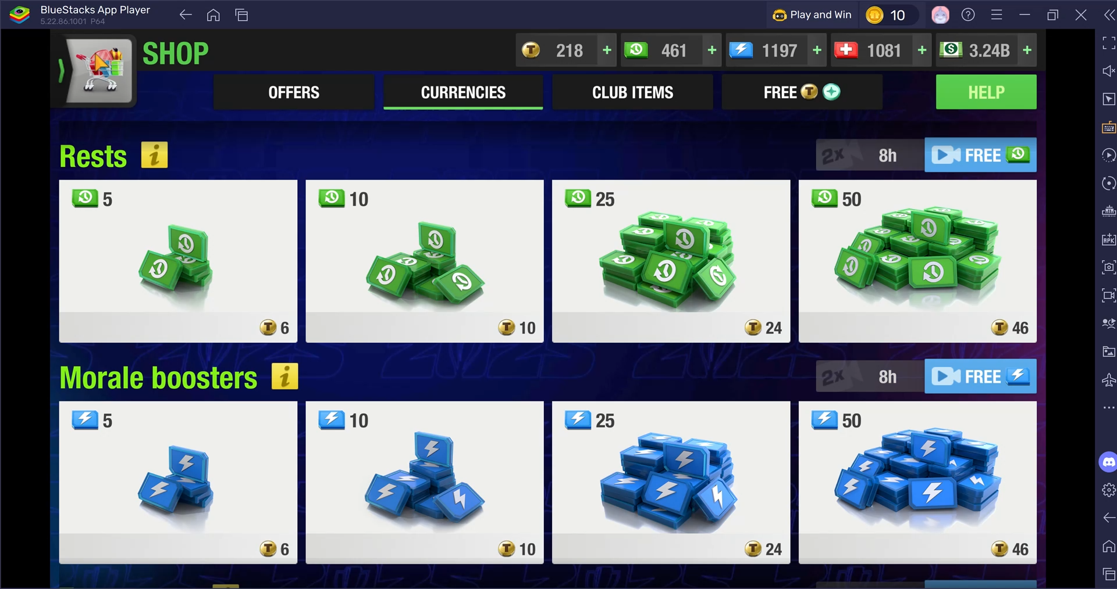
Experiments and Results
Notes:
Motivation is to reduce the time spent playing games while maintaining the same results

Slide 9
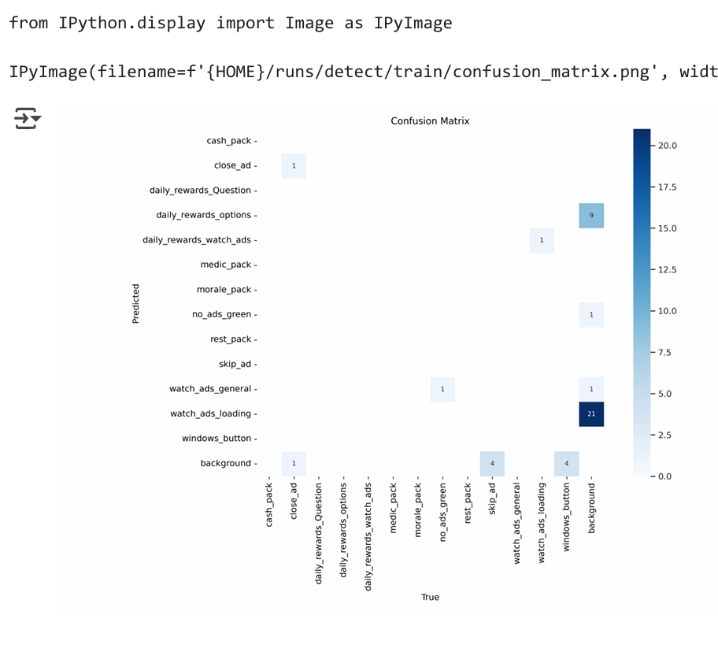
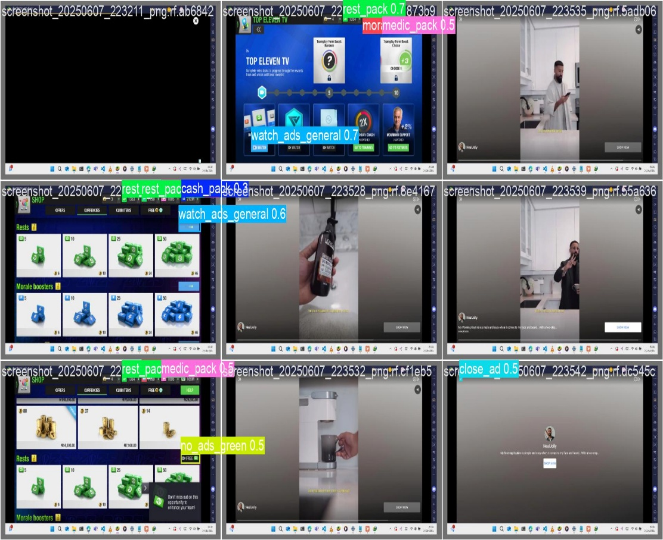
Experiments and Results
Confusion Matrix
Confidence against test images
Dataset: 50 annotated screenshots, 5+ object classes
Training: 10 epochs, YOLO11s model (9.4M parameters)
Performance: Overall mAP 0.651, best class (skip_ad) achieved 1.0 mAP
Real-world Success: 85% automation success rate in live gameplay
Notes:
Motivation is to reduce the time spent playing games while maintaining the same results

Slide 10
Model Generalization: Limited to current Top Eleven UI version - performance degrades with game updates or interface changes
Detection Accuracy: 10-15% false positive rate for similar UI elements, particularly challenging with dynamic ad content variations
System Dependencies: Windows-only implementation requiring specific BlueStacks configuration and fixed screen resolution
Ethical Considerations: Potential violation of game terms of service raises questions about automated vs. manual gameplay fairness
Discussions
and
Limitations

Slide 11
Adding more object classes to be detected.
Adding more functionality to the Bot (player training, transfer market)
Training more models for different screens sizes and resolutions (1920 x 1080, 2560 × 1664, 2880 × 1800 )
Conclusion and Future works

Slide 12
Both
Awwal
Temidire
Joint Problem Solving
Team Contribution
Dataset Development
Model Optimization
YOLO11 Training
Error Handling
System Architecture
User Interface
Interaction Logic:
Computer Vision Integration

Slide 13
References
Redmon, J., Divvala, S., Girshick, R., & Farhadi, A. (2016). You only look once: Unified, real-time object detection. In Proceedings of the IEEE conference on computer vision and pattern recognition (pp. 779-788). IEEE. https://doi.org/10.1109/CVPR.2016.912.
Chen, X., Wang, S., Fu, B., Long, M., & Wang, J. (2019). Catastrophic forgetting meets negative transfer: Batch spectral shrinkage for safe transfer learning. In Advances in neural information processing systems (pp. 1906-1916). Neural Information Processing Systems Foundation. https://doi.org/10.5555/3454287.34544573.
Jocher, G., Chaurasia, A., & Qiu, J. (2023). Ultralytics YOLOv8: A new real-time object detection and image segmentation model. Ultralytics. Retrieved from https://github.com/ultralytics/ultralytics

